Slide 1

The "CHIEF" Model
A New Era for Survival Analysis in Pathology
Leveraging Weakly Supervised Foundation Models for Prognosis
Based on Nature 2024: "A pathology foundation model for cancer diagnosis and prognosis prediction"

Slide 2
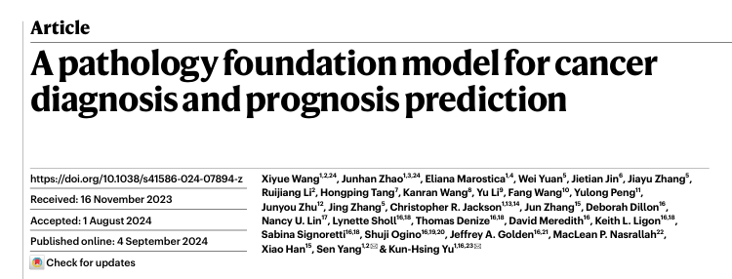
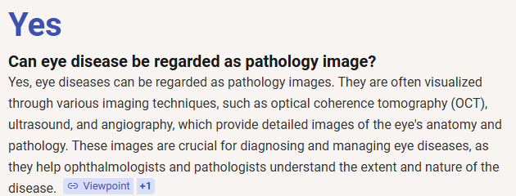
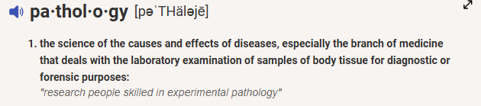
Notes:
"The CHIEF Model: A New Era"
Opening: "Good morning/afternoon everyone. Today I want to discuss a paper published in Nature earlier this year regarding the 'CHIEF' model. It stands for Clinical Histopathology Imaging Evaluation Foundation."
The Hook: “As a survival analysis group, we are used to dealing with clinical tabular data—age, tumor stage, gene expression. We are also interested in the actual pathology image. Since I want to make my presentation after Haoling to be logically coherent, and helpful. So, I check whether OCT for eye disease can be regarded as pathology image. The answer is yes. However, it's unstructured and massive."
The Point: "This presentation isn't just about a new neural network. It's about a methodology to turn gigapixels of image data into a single, robust prognostic covariate that we can plug directly into our Cox Proportional Hazards models. We are going to look at how this 'Foundation Model' approach works and how we can use it."

Slide 3

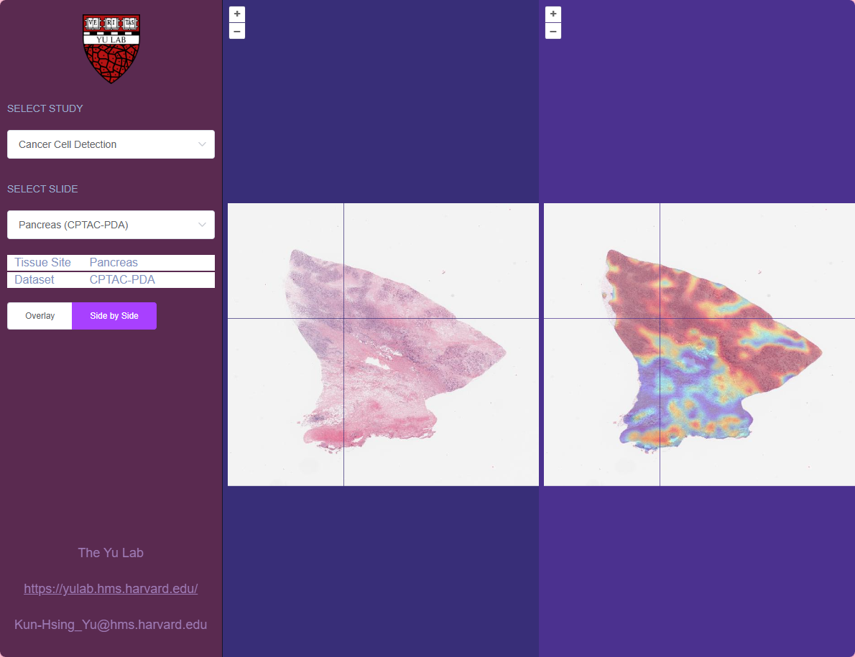

image-viewer
The High-Dimensional Covariate
The Challenge: Whole Slide Images (WSIs) contain gigapixels of data. Traditional survival analysis (Cox PH) cannot ingest raw pixels directly.
Old Approach: Manual feature engineering (nuclear grade, mitosis count) or small, task-specific CNNs that overfit.
New Reality: We need a way to turn an entire slide into a robust, low-dimensional vector $x_{img}$ that correlates with time-to-event.
Notes:
"The High-Dimensional Covariate"
Visual Context: "On the right, you see a standard pathology slide with a heatmap overlay. A single Whole Slide Image (WSI) can be 100,000 by 100,000 pixels."
The Statistical Hurdle: "If we treated pixels as covariates, we would have larger number of covariates than the number of samples. We have billions of features (pixels) and maybe only 500 patients (n). Standard regression fails here."
Historical Context: "In the past, we solved this by manual feature engineering. A pathologist would count mitoses or grade nuclei. We would take those counts—maybe 5 or 6 numbers—and put them in our model. But that throws away 99% of the information."
The Goal: "We need a mathematical transformation—call it function —that maps this massive image tensor into a low-dimensional vector , where preserves prognostic information. CHIEF is essentially that function ."

Slide 4
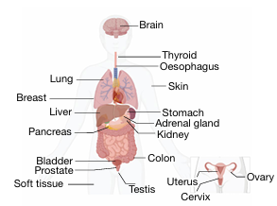
What is a "Foundation Model"?
A Foundation Model is a large neural network trained on massive datasets to handle a wide variety of downstream tasks.
General Purpose: Unlike specific models (e.g., "Lung Cancer Detector"), it understands "tissue" generally.
Self-Supervised: Learned from data patterns without expensive pixel-level manual annotations.
Adaptable: We "freeze" the model and use it as a feature extractor for our survival regressions.
Notes:
What is a Foundation Model? (5 Minutes)
"Paradigm Shift: Task-Specific vs. Generalist"
Definition: "In Deep Learning, the old paradigm was 'Task-Specific'. If you wanted to predict survival in Lung Cancer, you trained a model only on Lung Cancer images. It was brittle and overfit easily."
The Foundation Concept: "A Foundation Model is different. It is trained on everything—lung, breast, colon, prostate—simultaneously. It learns the general concept of 'tissue structure', 'abnormality', and 'cellular architecture'."
Analogy: "Think of it like a pre-med student. They learn general anatomy and biology (Pre-training) before they specialize in oncology (Fine-tuning). Because they have that general foundation, they learn the specialty much faster."
Relevance to Us: "For us, this means we don't need 10,000 patients to train a survival model anymore. We can take this pre-trained 'brain', extract features from our small cohort of 200 patients, and get statistically significant results."

Slide 5






Meet CHIEF (Clinical Histopathology Imaging Evaluation Foundation)
Scale
Resolution
Intelligence
Trained on 60,530 Whole Slide Images across 19 anatomical sites. That's 44 Terabytes of imaging data.
Uses a two-stage pretraining: Tile-level (local textures) and Slide-level (global context).
Uses Weak Supervision. It learns from slide-level labels (e.g., "Lung Cancer") rather than pixel masks.
Notes:
"Scale and Weak Supervision"
The Data: "The authors trained this on over 60,000 whole slide images. To put that in perspective, most survival papers in our field use the TCGA dataset, which is about 10,000 slides total. This is 6x larger."
Weak Supervision (Crucial Concept): "This is the most important technical detail. They did not have pathologists circle every cancer cell. That is 'Strong Supervision' and it's too expensive."
The Approach: "Instead, they used 'Weak Supervision'. They just told the model: 'This slide is from a Lung Cancer patient.' The model had to figure out by itself which parts of the image made it 'Lung Cancer'. This allows them to scale to datasets where we don't have pixel-level annotations."

Slide 6
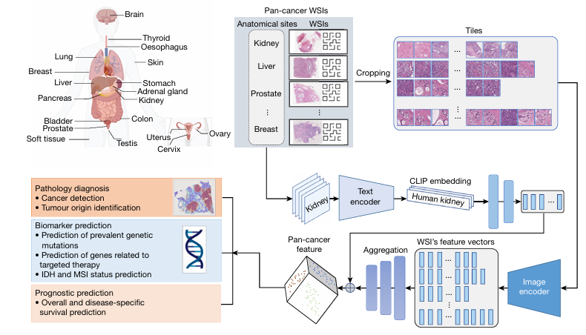
How It Works: The Pipeline
Step-by-Step
Tiling: WSI is cut into thousands of small squares (tiles).
Feature Extraction: CTransPath (a Vision Transformer) converts each tile into a vector.
.
Global Aggregation: A specialized attention mechanism pools these thousands of vectors into one Slide Embedding.
4.
Downstream Task: This single embedding is fed into a Survival Head (Cox/Log-Rank).
Notes:
"The Architecture Pipeline"
Walkthrough (Left to Right):
Tiling: "A slide is too big for GPU memory. We chop it into small squares called patches or tiles (usually 256x256 pixels)."
Encoder (CTransPath): "Every tile is passed through a smaller neural network (a Transformer). This turns the image patch into a vector of numbers."
Aggregation: "Now we have thousands of vectors—a 'bag' of vectors. We need to condense them into one 'Patient Representation'. They use an Attention Mechanism here. The model learns to assign a weight to every tile. Tiles with tumor get high weights; tiles with background fat get low weights."
Pooling: "We take the weighted average. This results in one final vector representing the whole patient."
Output: "This final vector is what we care about. It effectively summarizes the patient's entire biological visual state."
We use tiling because (1) whole slides are too big for GPU memory, and (2) resizing the image would destroy the cellular-level details (mitosis, nuclear grade) that are critical for predicting patient survival.
You may ask: the final input is an image, and the final output is a survival prediction. So why do we need text?
Imagine you are teaching a medical student (the Image Model) how to spot cancer.
Without Text: You just show them slides and say "Bad" or "Good" (Labels 0 or 1). The student learns to guess, but doesn't understand why.
With Text: You show them a slide and say, "This is invasive ductal carcinoma with high nuclear grade." (This is the Text Encoder output).
The Text Encoder acts as the "Teacher." It has already read all the medical textbooks (pre-trained on PubMed). It guides the Image Model to look for specific features that match the medical definition of cancer.
We use the text encoder during training to structure the image features. Once the image model learns that structure, the text encoder is redundant. Discarding it makes the model faster and allows us to make predictions based solely on the patient's biological tissue, without relying on external pathologist reports.

Slide 7

Methodology: From Pixels to Hazard Ratios
1. Input Data
2. The Risk Score
We take a patient's WSI X and their survival tuple (T, E), where T is time and E is the event indicator (death/recurrence).
Notes:
"From Pixels to Hazard Ratios"
The Math: "Let's look at the formula on the right. This should look familiar. It's the proportional hazards assumption."
is our baseline hazard.
Usually, the exponent contains (Age, Sex, etc.).
The Substitution: "Here, they replace the linear combination of clinical covariates with . The neural network outputs the log-risk."
Loss Function: "They train this using a differentiable version of the Concordance Index (C-Index) or the Cox Partial Likelihood loss. The model adjusts its weights to maximize the likelihood of the observed ordering of events."
Key Takeaway: "The model is explicitly optimizing for ranking patients correctly by survival time, handling censorship just like a standard Cox model does."

Slide 8
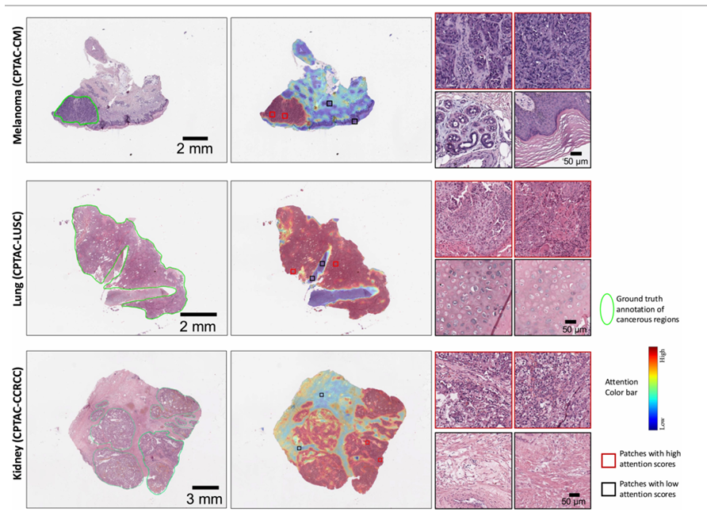
Interpretable AI
One major critique of "Black Box" models in survival analysis is the lack of interpretability.
Attention Maps: CHIEF assigns an "attention score" to every tile. We can visualize exactly which cells the model used to determine high risk.
Example: High-risk scores in colon cancer often focus on stromal regions and tumor budding, not just the tumor bulk.
Notes:
"Opening the Black Box"
The Critique: "Reviewers always ask: 'The model predicts high risk, but why?'"
The Solution (Attention Maps): "Because of the aggregation step I mentioned earlier, we can extract the attention weights. We can overlay these weights back onto the original image."
The finding: "Look at the image on the right. The red areas are where the model is 'looking'. Interestingly, for prognosis, it often looks at the stroma (the tissue surrounding the tumor) and immune infiltration, not just the tumor cells themselves. It is picking up on the tumor microenvironment."

Slide 9
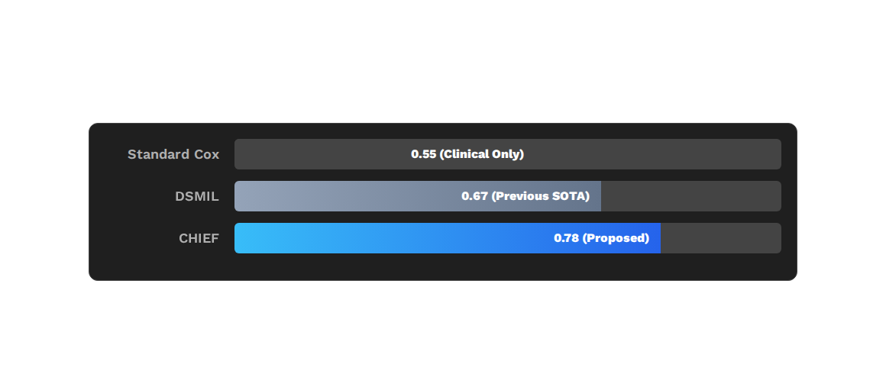
Survival Prediction Performance (C-Index)
Validation on independent external cohorts (average across cancer types)
*CHIEF consistently stratifies patients into High vs. Low risk (p < 0.005)
Notes:
"Benchmarking C-Index"
The Baseline: "Standard Cox models using just clinical data (Stage, Age) usually achieve a C-index around 0.55 to 0.65 in complex cancers. It's better than random (0.5), but not great."
The Competition: "DSMIL was the previous state-of-the-art deep learning model. It hit around 0.67."
CHIEF: "CHIEF jumps to nearly 0.80. In survival analysis, a jump of 0.10 in C-index is massive. It turns a 'statistically significant' result into a 'clinically useful' tool."

Slide 10
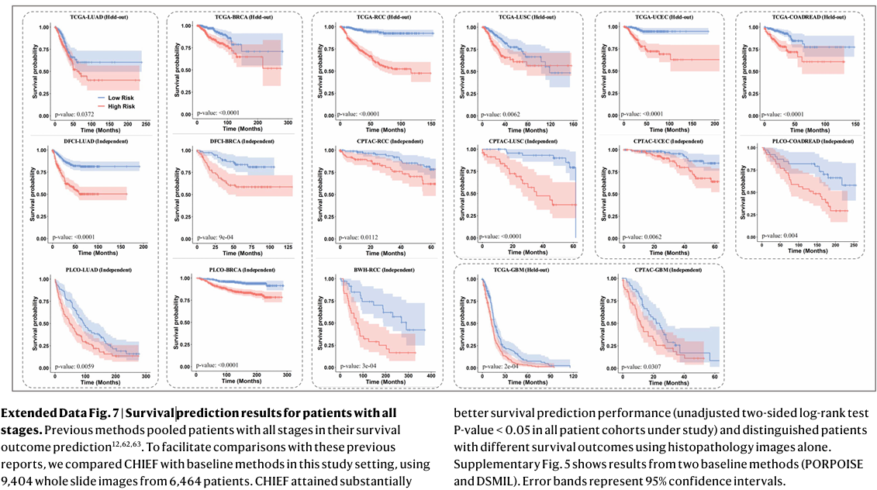
Risk Stratification (KM Curves)
Separating Risk Groups
This works even within the same tumor stage, meaning the image contains prognostic signal independent of TNM staging.
When we split patients based on the median CHIEF risk score, we see significant separation in survival curves.
Notes:
"Kaplan-Meier Analysis"
The Procedure: "After the model predicts a risk score for every patient in the test set, they split the cohort at the median score (High Risk vs. Low Risk)."
The Result: "The KM curves separate beautifully. The Log-Rank p-value is extremely low ()."
Multivariate Analysis: "Crucially, when they put the 'CHIEF Score' into a multivariate Cox model alongside Tumor Stage and Grade, the CHIEF Score remains significant. This implies the image contains independent prognostic information that is not captured by TNM staging.“ "Held-out" data is data that the model never saw during the training process.
2. What Actually Happened (Independence)
When the authors combined them in a Multivariate Cox Model:
$$h(t) = h_0(t) \exp(\beta_1 \cdot \text{Stage} + \beta_2 \cdot \text{CHIEF})$$
Both $\beta_1$ (Stage) AND $\beta_2$ (CHIEF) remained statistically significant.
The Meaning: This proves that CHIEF is measuring something different than Stage.
The Implication: Even if two patients have the exact same tumor stage (e.g., both Stage II), the CHIEF model can still distinguish who will survive longer based on visual patterns (like immune infiltration or stromal texture) that the staging system ignores.
3. Why this is "Crucial"
If CHIEF wasn't independent, it would be scientifically interesting but clinically useless. Doctors would say, "Why run this complex AI model if I can just look at the Stage?"

Slide 11
Foundation Models vs. Standard CNNs
Feature | Standard CNN (e.g., ResNet) | Foundation Model (CHIEF)
Training Data | Small (~1k slides), Single Site | Massive (~60k slides), 19 Sites
Annotation | Requires ROI masks (expensive) | Weak labels (slide-level diagnosis)
Context | Local Patches only | Whole Slide Context (Global)
Survival C-Index | Moderate (0.60 - 0.70) | High (0.75 - 0.80+)
Notes:
"Why Foundation Models Win"
Summary: "To summarize the shift in our field: We are moving from small, manually annotated datasets to massive, weakly supervised ones."
Context: "The 'Global Context' row is vital. A standard CNN looks at a small patch and asks 'Is this cancer?'. CHIEF looks at the whole slide and asks 'How aggressive is this cancer structure relative to the surrounding tissue?’”
ROI stands for Region of Interest.
In the context of digital pathology and this presentation (specifically Slide 4 and Slide 10), an ROI Mask refers to a pixel-level annotation created by a human expert.

Slide 12





How We Can Use This
1. Pre-trained Weights
2. Feature Extraction
3. Hybrid Models
We don't need to train CHIEF. We download the weights and run our WSIs through it.
Output: A fixed-length vector per patient. This becomes a new column in our dataset.
Fit a Cox Model using:
h(t) ~ Age + Stage + CHIEF_Score
Notes:
"Practical Next Steps"
Action Plan: "So, how do we use this? We don't need 60,000 slides. We can use the pre-trained weights."
Workflow:
Take our current dataset (e.g., our 300 immunotherapy patients).
Run the slides through CHIEF to get the "feature embeddings" (the vector representation).
Export these vectors to a CSV file.
Load that CSV into R or Python (lifelines/survival package).
Regress survival time against these vectors + clinical variables.
Value: "This gives us a high-tech 'image signature' variable for our existing projects with very little overhead."

Slide 13
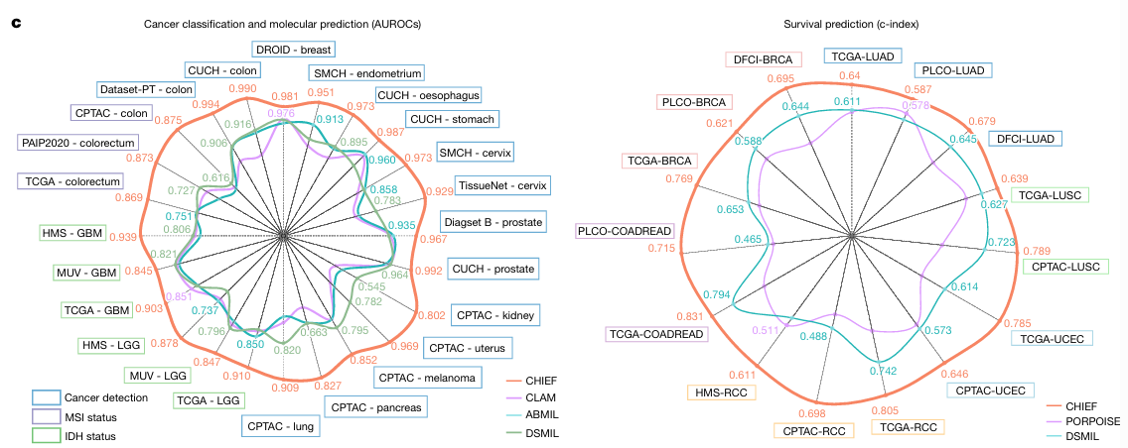
Notes:
We pretrained CHIEF in a weakly supervised manner using 60,530 WSIs representing 19 anatomical sites. During the pretraining process, we cropped the WSIs into non-overlapping imaging tiles, and we encoded the anatomic site information of each WSI using the contrastive language–image pretraining (CLIP) embedding method to obtain a feature vector for each anatomic site. We merged the text and image embeddings to represent the heterogeneous pathology information from the training data. We then used the pathology imaging features extracted by CHIEF to infer cancer types directly.

Slide 14

Discussion
Questions?
Focus: Application to our current survival datasets
Paper: Wang et al., Nature (2024)
Notes:
"Q&A"
Prompt for Discussion: "I'd like to open it up. Do we think this image signature is a surrogate for something biological we already know (like genomic instability), or is it something entirely new?"
Potential Critique points to be ready for:
Domain Shift: Will this work if our scanner is different from the training scanners? (CHIEF is designed to be robust to this, but it's a valid concern).
Computational Cost: Processing WSIs requires GPUs, though inference is faster than training.

